Slide 1


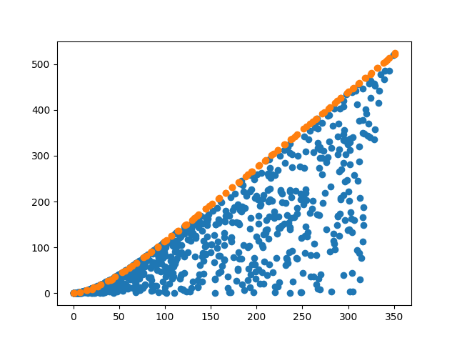
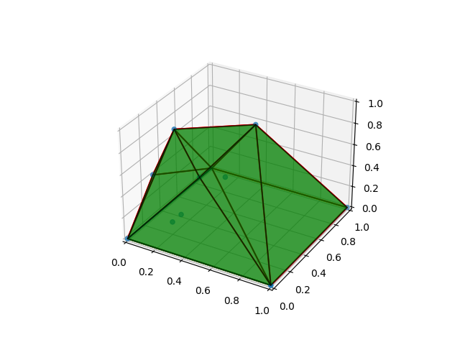
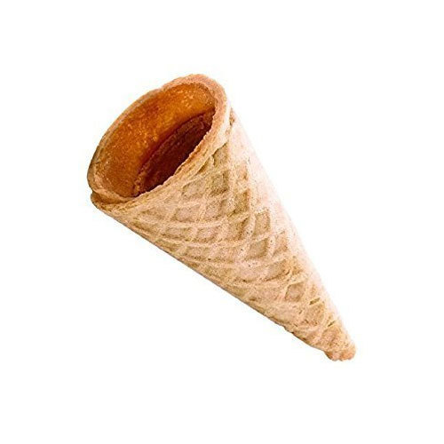
Afternoon program
V(r,h)->max (minimize –V(r,h))
f1 f2 f3 f4
better
Work on the completion of Desdeo Example
for cone/tin objective
check out: git: Day03 Notebook and scripts
desdeo-test-problem-and-Pareto-plot.py
Compute a Pareto front for Tent design:
→ 2 objectives: volume/surface (constant floor sidelength 1)
→ 3 objectives: two bar truss
→ 4 objectives: height, floor, surface, volume
Use 10 point designs in all cases to produce the Pareto front
Visualize some solutions on the Pareto front (for the report)
Send Pareto front to Bhupinder
We will collect and make combined Pareto front
A(r,h)->min

